Slide 1

Flock
Rideshare Application

Slide 2
(Uber and the PPA should) sit down and figure out how to work in a 21st century environment here in the city of Philadelphia and really focus on customers and what customers need … Philly is a big city and should have as many quality transportation options as possible …
Philadelphia Mayor Michael Nutter, October 27, 2014
Ridesharing is on the forefront of current debate and introduces a new aspect of lifestyle for many American commuters. Many large metropolitan areas in the US are currently participating in the use of mobile applications supporting community shared rides.

Slide 3
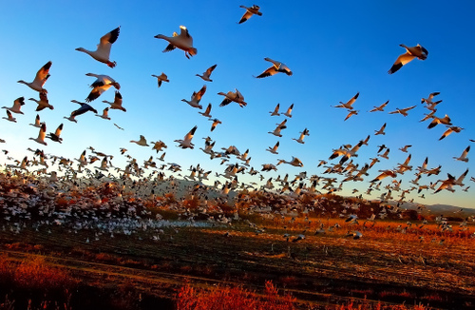
Why call it Flock?
Many cities like Washington DC and San Francisco have embraced the concept of
shared rides, although each in their own way.

Slide 4
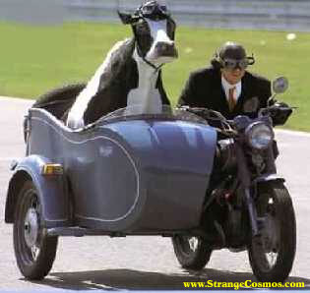
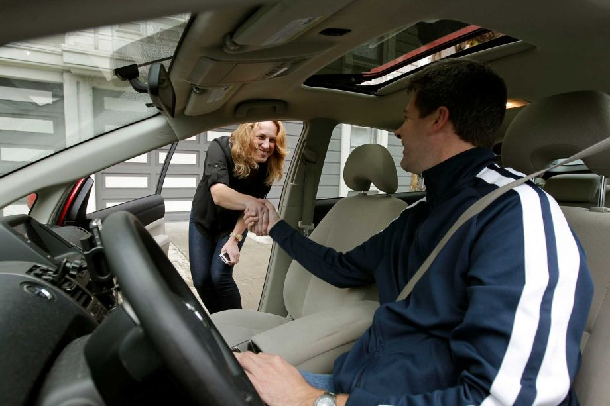
San Francisco’s Sidecar paved the way.
What a great way to meet people who think just like I do!
San Francisco’s youthful and communal culture appreciates all things retro and hipster.

Slide 5
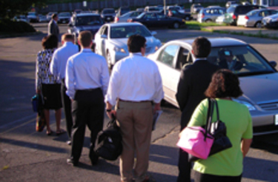
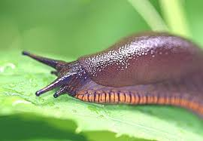
DC’s serious- minded government workers just want an efficient and cost–effective way to get to work.
G6 summit…National Security… Congress…
The Slug Lines

Slide 6
So what about Philadelphia? What sets us apart? What makes us unique?
Philadelphia is diverse.
Philadelphia has a lot of high culture.
Philadelphia has a lot of low culture.
Philadelphia has a lot of maniacal sports fans.
Philadelphia is a hub for international business.
What is Philadelphia to you?
Philadelphians do not wait in slug-lines, nor do they fancy riding around in hip sidecars…

Slide 7
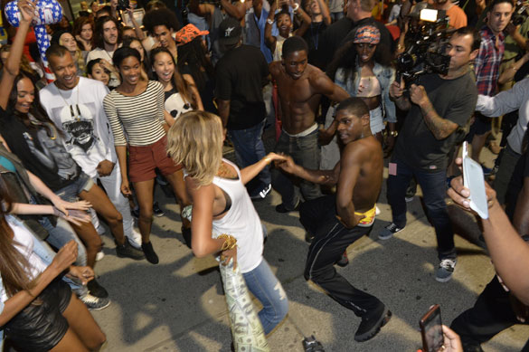

Slide 8
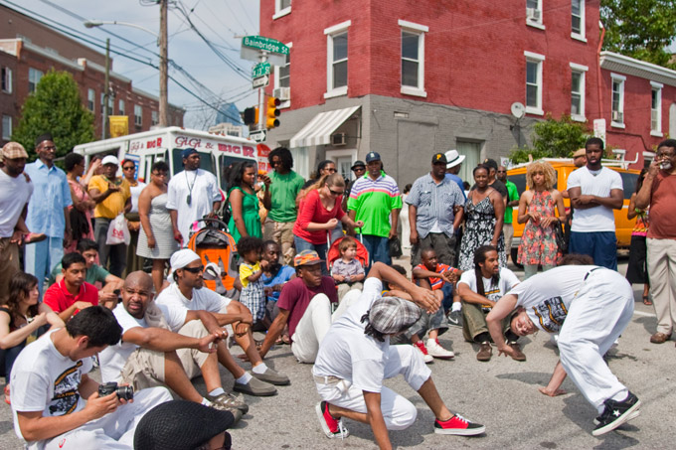

Slide 9
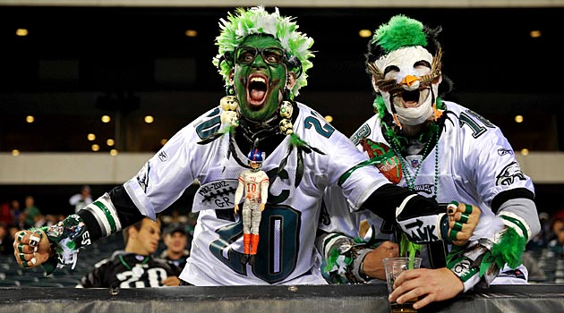

Slide 10
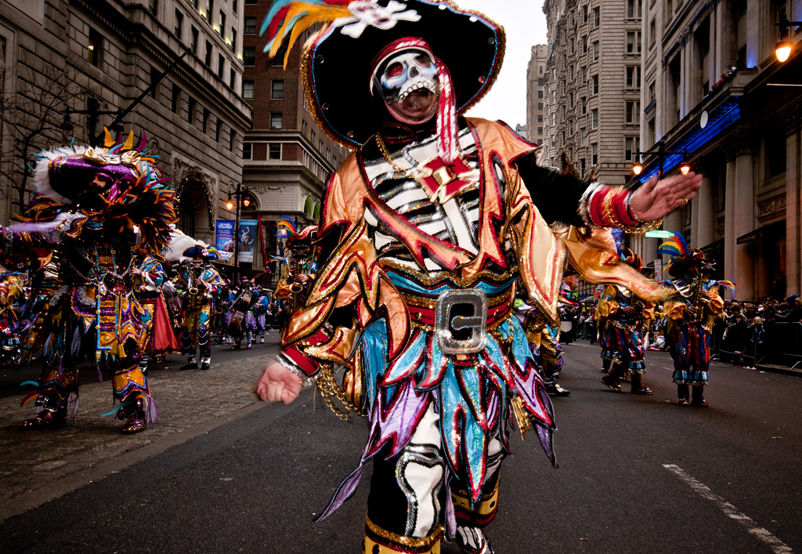

Slide 11
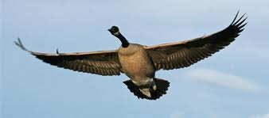
Philadelphia Flocks.
Proud. Free. Migratory. Loud.

Slide 12


Slide 13
Team D Development
Flock Rideshare App

Slide 14

Android Studio
Team D is using some tools outside the standard repertoire (Eclipse) to complete this project. As a member of Team D it is crucial to familiarize yourself with this technology.
Wikipedia:
“Android Studio is an integrated development environment (IDE) for the Android platform. It was announced on May 16, 2013 at the Google I/O conference by Google's Product Manager, Ellie Powers. Android Studio is available for developers to try (for free).”

Slide 15
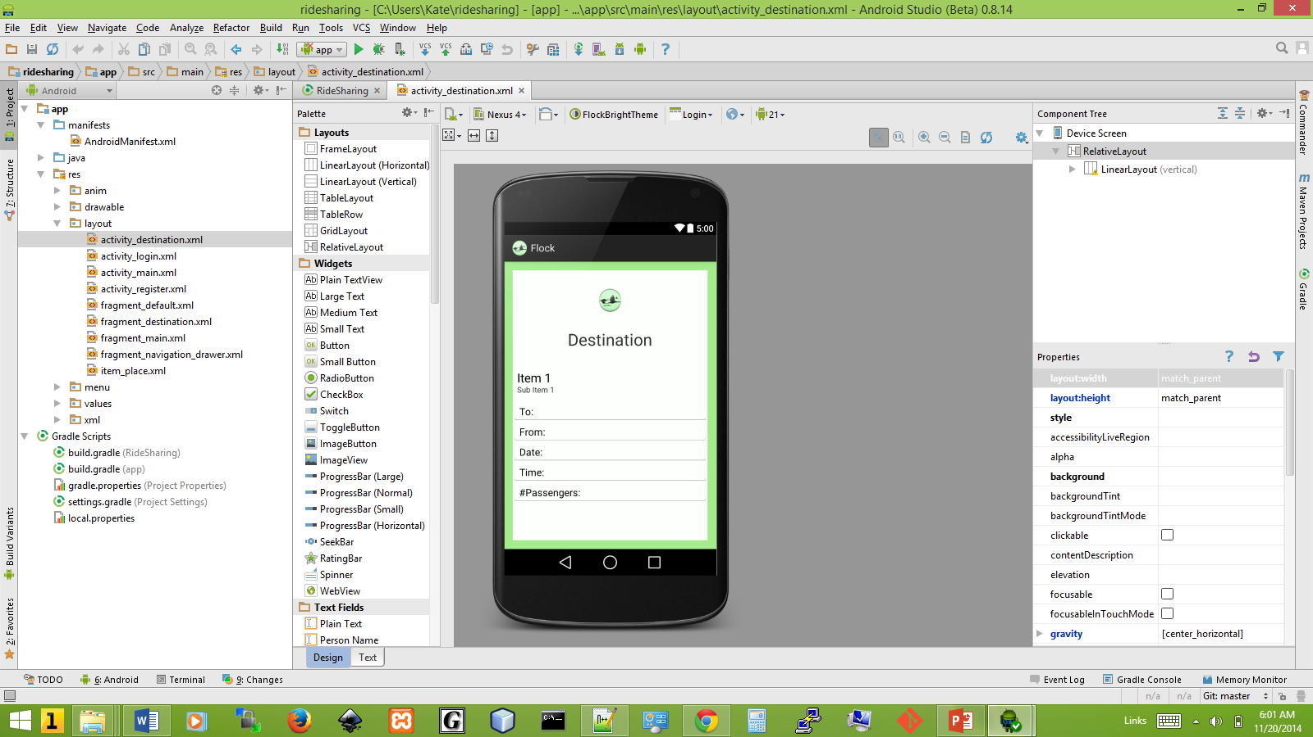

Slide 16
Reasons to use Android Studio
Drag and drop GUI designer.
Gradle Integration.
Native support for Google Cloud Platform.
Superior User Interface – IDE built specifically for Android Application Development.
Preview mode is in excellent shape.

Slide 17

What is ?
Wikipedia: “Gradle is a project automation tool that builds upon the concepts of Apache Ant and Apache Maven and introduces a Groovy-based domain-specific language (DSL) instead of the more traditional XML form of declaring the project configuration.”

Slide 18

Software for building software. Default build tool for Android Studio. An advanced build toolkit that manages dependencies and allows user to define custom build logic.
Build variants. Can build different versions of your application without having to create a separate project for each of them.
Dependencies. Manages project dependencies and supports dependencies from your local file system and from remote repositories. Which means we don’t have to search, download, and copy binary packages into the project directory.
Testing. The build system generates a test APK from the test sources in your project, so you do not have to create a separate test project. The build system can run your tests during the build process.

Slide 19

How does Flock communicate with the server?
Client uses soap to communicate with the server. Wikipedia: “kSOAP is a reputable library loved by developers who have the need to parse WSDL (Web Service Definition Language) and SOAP (Simple Object Access Protocol) messages.”

Slide 20
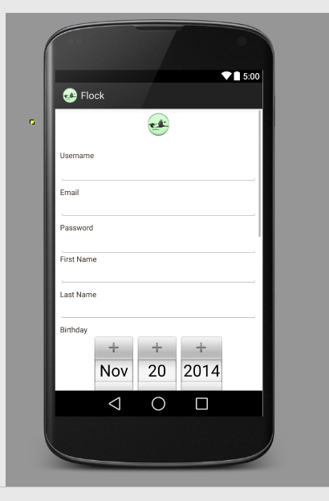
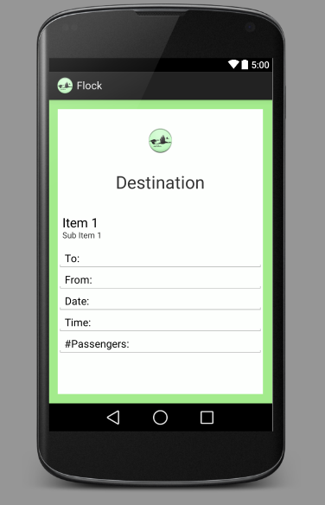
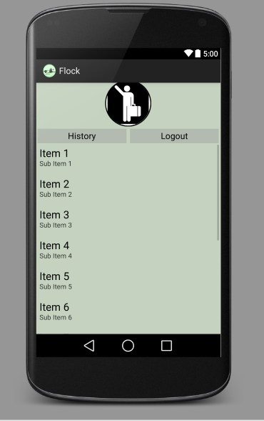
Screenshots in Progress

Slide 21

Flock Style

Slide 22
Styles v. Themes
Style: A resource file used to style a view.
Theme: A resource file used to style an activity.

Slide 23
Activity v. View
TheViewGroup subclass is the base class for layouts, which are invisible containers that hold other Views (or other ViewGroups) and define their layout properties.
Activity:
Something a user can do. The Activity class creates a window in which to place the User
Interface with setContentView(View). Activities can be full screen, floating or embedded (inside another activity) windows.
View:
The class that represents the building blocks of the user interface. It occupies a rectangular area on screen and does event handling and drawing. It is also the base class for Widgets, used to create the interactive UI components, and ViewGroup, used for layouts which are the invisible containers that hold Views.
What’s the difference?

Slide 24








The Flock Theme Colors
Wikipedia:
“In surveys made in Europe and the United States, green is the color most commonly associated with nature, youth, spring, hope and envy. In Europe and the U.S. green is sometimes associated with death, sickness, or the devil, but in China its associations are very positive, as the symbol of fertility. Because of its association with youth, it is sometimes used to describe someone who is inexperienced.”

Slide 25
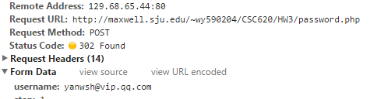
Why use JSON?
Traditionally, We use Query String to post data to server. There have two actions GET and POST
GET
POST

Slide 26
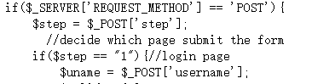
How do you fetch data in Server Side?
Problem
If we want to post 300 data, we should do this 300 times. We need to write many useless code to fetch those data both in Client side and Server Side.

Slide 27
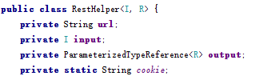
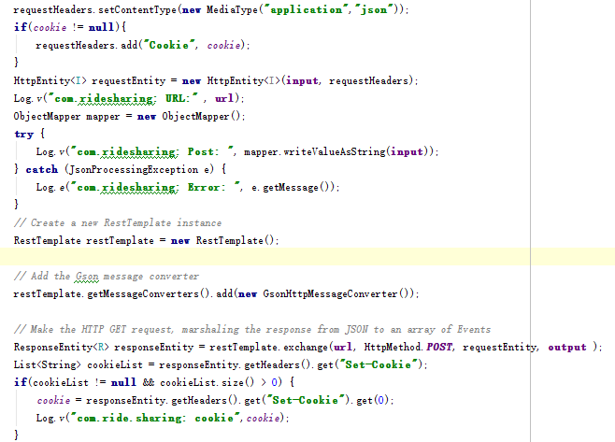
How’s JSON?
We use JSON to serialize and deserialize data base on Spring Framework.
give the object which you want to send.
Convert it to json code automatically.

Slide 28
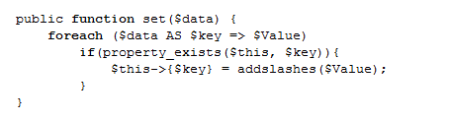
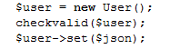
On Server Side

Slide 29
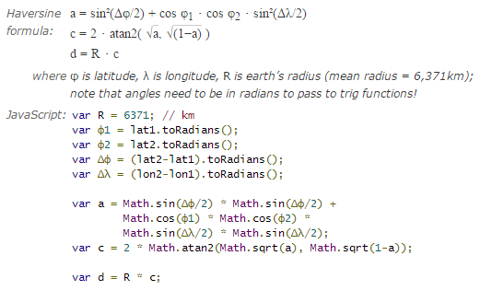
What we do this week?
Location filter
Google plus login
$sql = "SELECT *, ( 3959 * acos( cos( radians(" .$wish->fromlat . ") ) * cos( radians( fromlat ) ) * cos( radians( fromlng ) - radians(" . $wish->fromlng .") ) + sin( radians(" .$wish->fromlat . ") ) * sin( radians( fromlat ) ) ) ) AS distance FROM " . _table("Wish") . " HAVING distance < " . $distance;
Reference: http://en.wikipedia.org/wiki/Haversine_formula

Slide 30
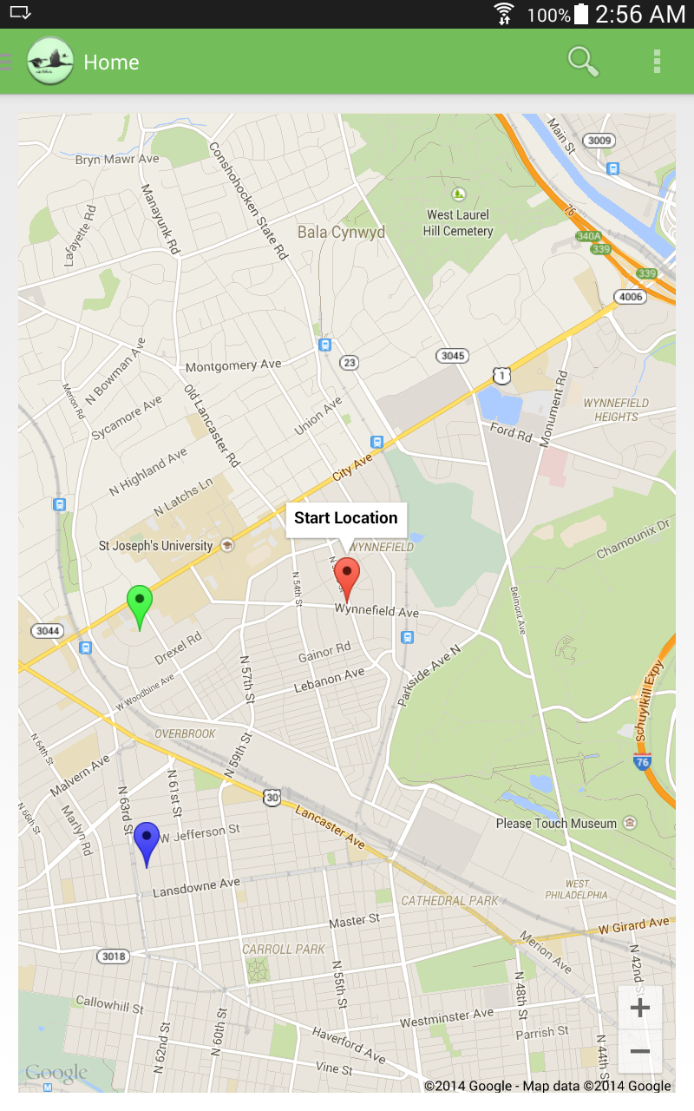
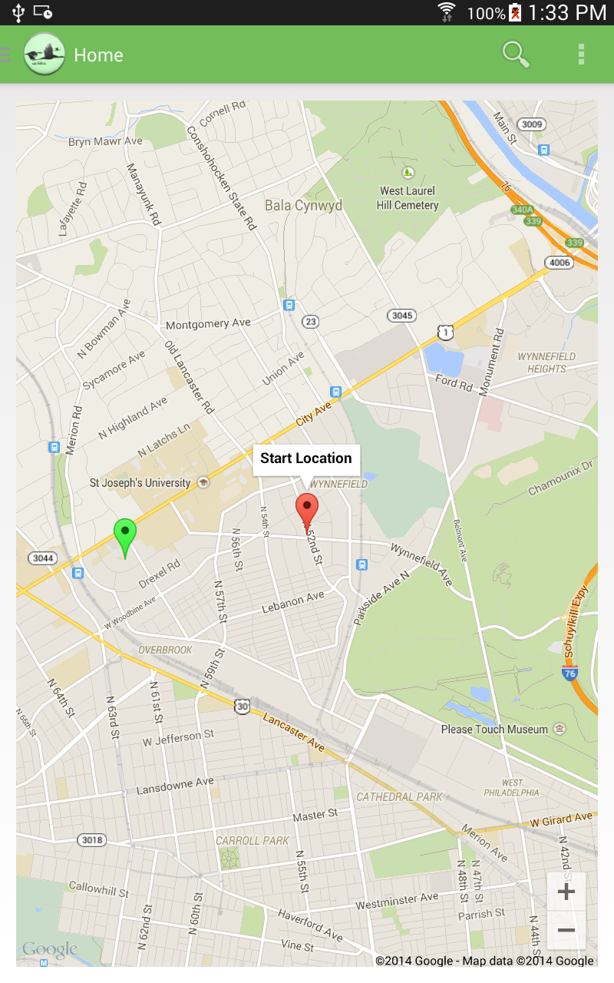

Slide 31
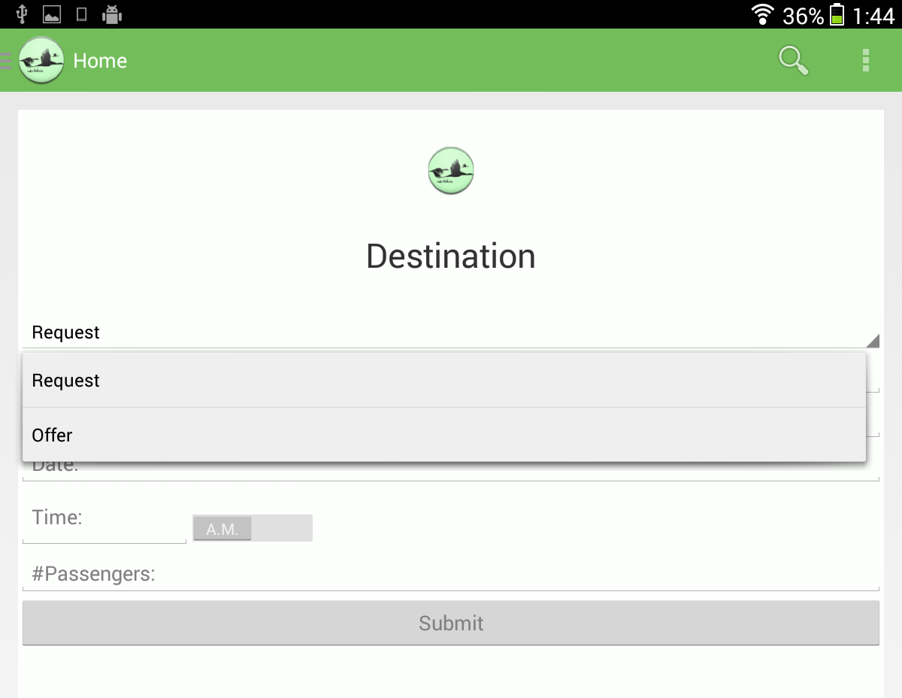

Slide 32
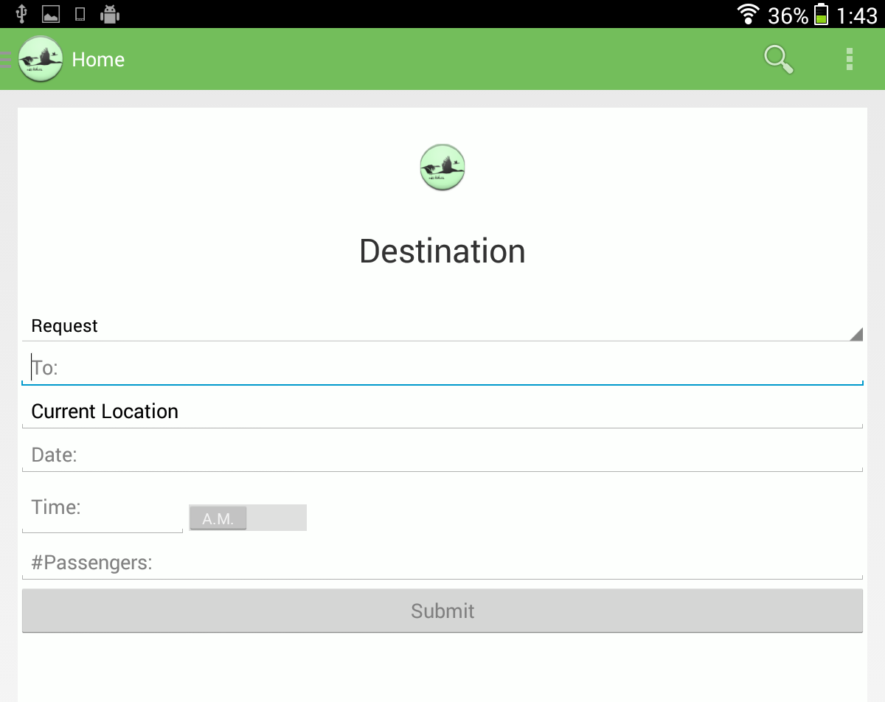

Slide 33
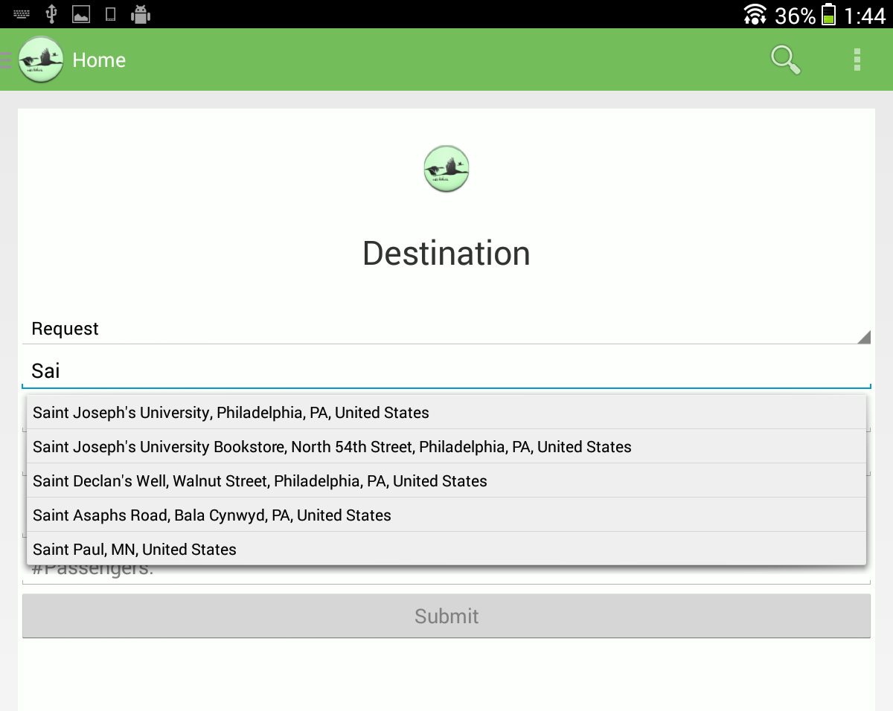

Slide 34
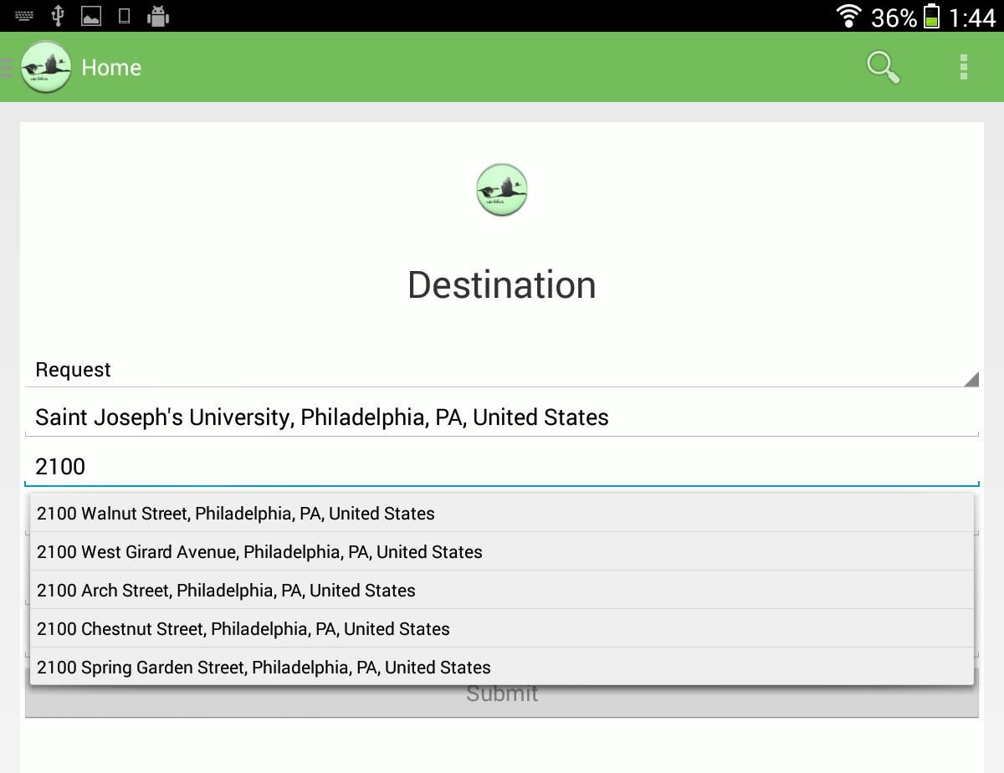

Slide 35
